Slide 1
Web Technologies (CP301)
Credits: 6 (Lect: 2+ Lab: 4)
Reference Book(s):
Developing Web Application, Ralph Moseley, Wiley India
Web Design, Joel Sklar, Cengage Learning

Slide 2
Chapter 3:
Client Side Scripting: HTML

Slide 3
Introduction to HTML
HTML : Hyper Text Markup Language
A browser understands and interpret the HTML tags, identifies the structure of the document (which part are which) and makes decision about presentation (how the parts look) of the document.
HTML also provides tags to make the document look attractive using graphics, font size and colors.
User can make a link to the other document by creating Hypertext Links also known as Hyperlinks.

Slide 4
Website Development Process
A Web site is composed of individual pages that are linked together each of these relating to a different aspects of your site such as news , links and biography.
It is a much like a SDLC ( Software development Life Cycle ).
Requirements
Design
Write Code
Test
Upload
Reiterate

Slide 5
Basic HTML
A page can be loaded into a browser by two ways
By writing a URL in the address bar
By manually open a file
The essential tags that are required to create a HTML document are:
<html>.............</html>
<head>.............</head>
<body>.............</body>

Slide 6
Basic HTML
HTML Tag <HTML>:
The <HTML> tag encloses all other HTML tags and associated text
within your document.
<HTML>
Your Title and Document (contains text with HTML tags) goes here
</HTML>
The slash mark is always used in closing tags.

Slide 7
Basic HTML
HEAD Tag <HEAD>:
HEAD tag comes after the HTML start tag. It contains TITLE tag to give
the document a title that displays on the browsers title bar at the top.
<HEAD>
<TITLE>
Your title goes here
</TITLE>
</HEAD>

Slide 8
Basic HTML
BODY Tag <BODY>:
The BODY tag contains all the text and graphics of the document with all
the HTML tags that are used for control and formatting of the page.
<BODY>
Your Document goes here
</BODY>
An HTML document, web page can be created using a text editor, Notepad or WordPad. All the HTML documents should have the extension .htm or .html

Slide 9
Basic HTML
Example:
<HTML>
<HEAD>
<TITLE>
My first Page
</TITLE>
</HEAD>
<BODY>
WELCOME TO MY FIRST WEB PAGE
</BODY>
</HTML>

Slide 10
Basic HTML
Attributes used with <BODY> :
BGCOLOR: used to set the background color for the document
<BODY BGCOLOR="yellow">
Your document text goes here.
</BODY>
TEXT: used to set the color of the text of the document
<BODY TEXT="red">
Document text changed to red color
</BODY>
BACKGROUND: It is used to point to an image file (the files with an extension .gif, .jpeg) that will be used as the background of the document.
<BODY BACKGROUND="filename.jpeg"> < Document background changed
/BODY>

Slide 11
Basic HTML
Attributes used with <BODY> :
MARGINS: Set the left hand/right hand margin of the document
<BODY LEFTMARGIN="60“ TOPMARGIN="60" >
This document is indented 60 pixels from the left hand side and also from top side of the page.
</BODY>
ALINK: Specifies the color of an active link in a document
<BODY ALINK="red">
Document active link color changed to red
</BODY>
LINK: Specifies the color of an unvisited link in a document
<BODY ALINK=“blue">
Document unvisited link color changed to blue
</BODY>

Slide 12
Basic HTML
Attributes used with <BODY> :
VLINK: Specifies the color of an unvisited link in a document
<BODY VLINK=“yellow">
Document visited link color changed to yellow
</BODY>

Slide 13
Basic HTML
Container and Empty Tags :
Container Tags : Tags which have both the opening and closing i.e.
<TAG> and </TAG> are called container tags.
Empty Tags: Tags, which have only opening and no ending, are called empty tags. Line break <BR> or <BR /> and <HR /> tags are empty tags.

Slide 14
Basic HTML
Formatting web page :
HTML has six header tags <H1>, <H2>...........<H6> used to specify section headings. Text with header tags is displayed in larger and bolder fonts than the normal body text by a web browser.
Every header leaves a blank line above and below it when displayed in browser.
<HTML>
<HEAD>
<TITLE>
My first Page
</TITLE>
</HEAD>
<BODY>
<h1> Welcome to my first web page </h1>
</BODY>
</HTML>

Slide 15
Basic HTML
Formatting web page :
Browsers ignore extra space within HTML document.
For Example: You can have text “Hello BVM
” in
HTML document but in browser it display, “Hello BVM".
Paragraph tag <P>:
This tag <P> indicates a paragraph, used to separate two paragraphs
with a blank line.
<P> Welcome to the world of HTML </P>
Line Break Tag <BR>:
The empty tag <BR> is used, where the text needs to start from a new line and not continue on the same line. To get every sentence on a new line, it is necessary to use a line break.
Example:
National Institute of Open Schooling <BR> B-31B, Kailash Colony <BR>
New Delhi-110048

Slide 16
Basic HTML
Formatting web page :
Preformatted Text Tag <PRE>:
<PRE> tag can be used, where it requires total control over spacing and line breaks. Browser preserves your space and line break in the text written inside the tag. It uses courier font.
<PRE> Welcome to the world of HTML </PRE>
Horizontal Rule Tag <HR>:
An empty tag <HR> basically used to draw lines and horizontal rules. It can be used to separate two sections of text. It accept SIZE, COLOR, ALIGN attribute.
Example:
<BODY>
Your horizontal rule goes here. <HR>
The rest of the text goes here.
</BODY>

Slide 17
Basic HTML
Character Formatting Tags:
The character formatting tags are used to specify how a particular text should be displayed on the screen to distinguish certain characters within the document.
Boldface <B>
Italics <I>
Subscript <SUB>: displays text in Subscript
Superscript <SUP>: displays text in Superscript
Small <SMALL>: displays text in smaller font as compared to normal font
Big <BIG>: displays text in larger font as compared to normal font

Slide 18
Basic HTML
<FONT> Tag:
Attributes of <FONT> are:
COLOR: Sets the color of the text that will appear on the screen. It can be set by giving the value as #rr0000 for red or by name.
SIZE: Sets the size of the text, takes value between 1 and 7, default is 3.
FACE: Sets the normal font type, provided it is installed on the user’s machine. <FONT FACE="ARIAL"> bvm </FONT>

Slide 19
Basic HTML
Font Size | Heading | Point Size
7 | - | 36pt
6 | <h1> | 24pt
5 | <h2> | 18pt
- | <h3> | 14pt
4 | <h4> | 12pt bold
3 | Body text | 12pt plain
- | <h5> | 10pt
- | <h6> | 7pt
2 | - | 9pt

Slide 20
Basic HTML
List in Web Page:
HTML Supports several ways of arranging items in lists. The most
commonly used are:
Ordered List (Numbered List)
Unordered List (Bulleted List)
Ordered List <OL>
Ordered list also called as Numbered list, is used to present a numbered list of item in the order of importance or the item (paragraph) is marked with a number.
An ordered list must begin with the <OL> followed by an <LI> list item tag.

Slide 21
Basic HTML
List in Web Page:
Ordered List <OL> attributes:
START : Used for lists that need to start at values other than 1.
START always specified in default numbers, and is completed based on TYPE before display, For example, If START =5 it would display either an ‘E’, ‘e’, ‘V’, ‘v’, or ‘5’ based an TYPE attribute.
TYPE : allows marking list items with different types. By default the list Item markers are set to numbers 1,2,3… so on.
<OL type=“ï”>
i : Roman numerals i, ii, iii, iv.....
I : Roman Capitals I, II, III, IV.......
a : Lowercase letter a, ,b, c, ..........
A : Uppercase letters A, B, C, ............

Slide 22
Basic HTML
List in Web Page:
Unordered List <UL>:
Unordered List also called as bulleted list, used to present list of items marked with bullets. An unordered list starts with in <UL> followed by <LI> (List Item) tag. Use of <UL> is very similar to <OL> (ordered list).
Example:
<UL>
<LI> Brinjal
<LI> Cabbage
<LI> Tomato
</UL>

Slide 23
Basic HTML
List in Web Page:
Unordered List <UL> attributes:
TYPE: allows marking list items with different types. By default the list Item markers are set to bullets.
Other values are circle and square.
Example:
<UL type=“circle”>
<LI> BVM
<LI> ADIT
<LI> GCET
</UL>

Slide 24
Basic HTML
Graphics in Web Page <IMG>:
Images can be placed in a web page by using <IMG> tag. TYPE: allows marking list items with different types. By default the list Item markers are set to bullets.
Syntax:
<IMG SRC = image_URL>
Where SRC – Source of the image file
image_URL – represents the image file with its location.
Example:
<IMG SRC=logo.gif>
<IMG SRC= “logo.jpg” HEIGHT=“320” WIDTH=“240” ALT=“Alternate text for image” BORDER=“1” HSPACE=“10” VSPACE=“10”>

Slide 25
Basic HTML
Links in Web Page <A>:
Web pages are linked to one another through Hypertext Links.
Section of text or image in the HTML document can be linked to an external document or to a specific place within the same document.
Example:
<A HREF=“menu.html”> Click here </A>
<A HREF= “menu.html” TARGET=“_blank”> Click here </A>
<A HREF= “menu.html” TARGET=“_blank”>
<IMG SRC=“logo.gif” />
</A>

Slide 26
Basic HTML
Linking to a specific place within the same Document :
It is required to jump different sections in the same document. For this it needs two steps, first; identify section with a name and or second; use jumps to the location using the name used.
<A HREF="#section_name"> link to another section of the same document </A>
This link text jumps to the section named with HREF on click.
The # symbol before the section name is must.
<A NAME="section_name"> Beginning of the section </A>
The NAME attribute is used to identify a section with a name. It is a unique identifier within the document for the anchor.

Slide 27
Basic HTML
Linking to a specific place within the same Document :
Same folder, but different document:
<A HREF="document.html#section_name">
Different folder, different document:
<A HREF="foldername/document. html#section_name">
A different server:
<A HREF="http://www.bvmengineering.ac.in/foldername/doc1.html#section
_name>

Slide 28
Basic HTML
Tables <TABLE>:
A table is divided into rows <tr> and each row is divided into data cells
<td>.
A data cell can contain text, images, lists, paragraphs, forms, horizontal rules, tables, etc.
Example :
<table border="1">
<tr>
<td>row 1, cell 1</td>
<td>row 1, cell 2</td>
</tr>
<tr>
<td>row 2, cell 1</td>
<td>row 2, cell 2</td>
</tr>
</table>

Slide 29
Basic HTML
Tables <TABLE> attributes:
Border: Which sets the border width in pixels around the table.
Width: Which in this case is as a percentage of the screen
Cellpadding: to give the distance in pixels between the inner border and
the text
Cellspacing: Which sets the spacing in pixels between the inner and outer borders.
Rowspan: The rowspan attribute specifies the number of rows a cell
should span.
Colspan: The colspan attribute specifies the number of columns a cell should span.

Slide 30
Basic HTML
Forms in Web Page <FORM>:
HTML forms provide a simple and reliable user interface to collect data from the user and transmit the data to a server-side program for processing.
The server simply reads all the HTTP data sent to it by the browser, then returns a Web page to the client.
Each of the controls typically has a name and a value, where the name is specified in the HTML and the value comes either from user input or from a default value in the HTML.

Slide 31
Basic HTML
Forms in Web Page <FORM>:
<form action=“processform.php” name= “f1” method =“POST”>
The action attributes tells the HTML where to send the collected information.
The method attribute describes the way to send it.
There are two types of Method:
GET
POST

Slide 32
Basic HTML
Forms in Web Page <FORM>:
GET Method:
An HTTP GET request, appends the form data to the end of the specified URL after a question mark.
GET is the default and is also the method that is used when the user types a URL into the address bar or clicks on a hypertext link.
Advantage of GET Method:
Save the results of a form submission: you can submit data and bookmark the resultant URL, send ita normal hypertext link. Google.com, yahoo.com etc to a other by email, or put it in.

Slide 33
Basic HTML
Forms in Web Page <FORM>:
POST Method:
HTTP POST, sends the data after the HTTP request headers and a blank line.
Advantage of POST Method:
When POST is used, the data is sent on a separate line.
POST is Secure than GET.

Slide 34
Basic HTML
<FORM> Elements:
<INPUT> tag is used to collect information from the user.
Different Types of Input:
<input type=“text” name=“fn” id=“fn1” value=“fname”/>
<input type=“password”/>
<input type=“radio”/>
<input type=“checkbox”/>
<input type=“file”/>
<input type=“submit”/>

Slide 35
Basic HTML
<FORM> Elements:
Different Types of Input:
<input type=“button”/>
<input type=“image”/>
<input type=“reset”/>
<input type=“hidden”/>: allows hidden data to be passed along with form. (not seen by user)
<textarea name=“add1” id=“add11” rows=“10” cols=“10”>

Slide 36

Basic HTML
<FORM> Elements:
Drop Down Menu:
A SELECT element presents a set of options to the user
<SELECT NAME=“FavLang" >
<OPTION VALUE=“C“ Selected > C </OPTION>
<OPTION VALUE=“C++“ > C++ </OPTION>
<OPTION VALUE=“JAVA“> Java </OPTION>
</SELECT>

Slide 37
Basic HTML
<FORM> Elements:
Drop Down Menu:
<SELECT NAME=“FavLang" >
<OPTION Selected disabled > Select Language </OPTION>
<OPTION VALUE=“C“ > C </OPTION>
<OPTION VALUE=“C++“ > C++ </OPTION>
<OPTION VALUE=“JAVA“> Java </OPTION>
</SELECT>

Slide 38
Basic HTML
<FORM> Elements:
List Box:
List boxes are used when multiple selections are permitted or a specific visible size has been specified.
<SELECT NAME=“FavLang“ size=“2”>
<OPTION VALUE=“C“ > C </OPTION>
<OPTION VALUE=“C++“ > C++ </OPTION>
<OPTION VALUE=“JAVA“> Java </OPTION>
</SELECT>

Slide 39
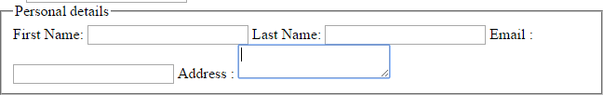
Basic HTML
Fieldset and Legend:
Fieldset: draws a rectangle around the area.
Legend: gives heading to each input section.
Example:
<fieldset>
<legend> Personal details</legend> First Name: <input type=text /> Last Name: <input type=text />
Email Address
: <input type=text />
: <textarea type=text />
</fieldset>

Slide 40
Basic HTML
Web Site Structure :
A Web site is collection of pages associated by hyperlinks , but it
should be broken up into area for structure.
Your site is broken into several sub-sites.
A website has a root directory which is entered first , then several sub-directories that serve as the sub-sites.
www.mywebsite.co.in
 index.html ( homepage)
 Department ( All department related files (pages))
 Images ( images and other files (pages))
 CSS (All CSS files)
 JS (All JavaScript files)

Slide 41
Introduction to XHTML
XHTML stands for Extensible Hypertext Markup Language
XHTML is aimed to replace HTML
XHTML is almost identical to HTML 4.01
XHTML is stricter and cleaner version of HTML
XML is a markup language designed for describing data
XHTML is a Bridge between HTML and XML

Slide 42
Introduction to XHTML
XHTML elements must be properly nested.
XHTML elements must always be closed.
XHTML elements must be in lowercase.
XHTML documents must have one root element.
Attribute names must be in lower case.
Attribute values must be quoted.

Slide 43



Introduction to XHTML
DOCTYPE declaration of XHTML:
<!DOCTYPE html PUBLIC "-//W3C//DTD XHTML 1.0 Transitional//EN"
"http://www.w3.org/TR/xhtml1/DTD/xhtml1-transitional.dtd">
This is what the <html> element looked like in XHTML:
<html xmlns="http://www.w3.org/1999/xhtml" xml:lang="en" lang="en">
Here is a typical XHTML <head> section:
<head>
<meta http-equiv="Content-type" content="text/html; charset=UTF-8" />
<title>My First XHTML Page</title>
<link rel="stylesheet" type="text/css" href="style.css" />
</head>

Slide 44
Introduction to XHTML
XHTML elements must be properly nested
<b><i> bold and italic </b> </i> is wrong
<b><i> bold and italic </i> </b> is correct
XHTML documents must be well-formed
<html>
<head>……..</head>
<body>……..</body>
</html>
If an HTML tag is not a container, close it like this :
<br />, <hr />, <img src=“smile.gif” />

Slide 45
Introduction to XHTML
META tag:
Metadata is information about information in this context machine understandable information about web resources.
It can be included in both HTML and XHTML to describe the actual
documents rather than the document’s content.
Metadata is included in the head section of web page.
Meta tags are used to provide information to search engine. They pick up the data you give and also control some extent where they go on your site following links.

Slide 46
Introduction to XHTML
META tag:
<html>
<head>
<title> My Web Page </title>
<meta name =“author” content=“Kirti Sharma”/>
<meta name =“description” content=“This page is related to information of faculties of bvm”/>
</head>
</html>

Slide 47
Introduction to XHTML
META tag:
<html>
<head>
<title> My Web Page </title>
<meta name =“expires” content=“Mon,20 Jul 2017 16:00:00 ”/>
<meta name =“refresh” content=“50;abc1.html”/>
</head>
</html>

Slide 48
Introduction to XHTML
META tag (Memory Cache):
Web browsers can cache pages for quick reviewing without having to request them again and re-download the document.
Each page has a TTL ( Time To Leave) . Usually 30 days, when the browser cache has been cleared or the allotted memory is all used up.
Browser can be stopped from caching a page. If it supports the meta elements http-equiv attribute.
For this we have to set value pragma is assigned to http-equiv
attribute and no-cache value to the content attribute.
<meta http-equiv =“pragma” content=“no-cache”/>

Slide 49
Introduction to XHTML
Character Entities:
&lt , &gt, &amp, &divide, &copy, &reg, &quot.
Frameset:
<frame> and <noframes> tags:
Dividing content on website when it is large, then use frames to
break information up and partition it.
To Separate the different elements of your content like to divide the page into rows and to place a new page into frame.

Slide 50
Introduction to XHTML
Frameset Example:
<frameset frameborder=“3” rows=“220,*,60”>
<frame name=“banner” src=“banner.html” />
<frame name=“main” src=“main.html” />
<frame name=“options” src=“options.html” />
</frameset>

Slide 51
Introduction to XHTML
<noframe>:
Only give a body section to such a program where you want to suppose browsers that don’t have frame capability.
<noframes>
<body>
<p> your browser does not support frame. </p>
</body>
</noframe>

Slide 52

Introduction to HTML5
HTML5 is the newest version of HTML, only recently gaining partial support by
the makers of web browsers.
It incorporates all features from earlier versions of HTML, including the stricter XHTML.
It is still a work in progress. No browsers have full HTML5 support. It will be many years – perhaps not until 2018 or later - before being fully defined and supported.
New features are based on HTML, CSS, DOM, and JavaScript

Slide 53
Goals of HTML5
Reduce the need for external plugins and scripts to show website content.
Make the rendering of web content universal and independent of the device being used.
Enhanced form controls and attributes
Built-in audio and video support (without plugins)
Support all existing web pages.
back and revise older websites.
With HTML5, there is no requirement to go

Slide 54



First Look at HTML5
Remember the DOCTYPE declaration from XHTML?
<!DOCTYPE html PUBLIC "-//W3C//DTD XHTML 1.0 Transitional//EN"
"http://www.w3.org/TR/xhtml1/DTD/xhtml1-transitional.dtd">
In HTML5, there is just one possible DOCTYPE declaration and it is simpler:
<!DOCTYPE html>
The DOCTYPE tells the browser which type and version of document to expect. This should be the last time the DOCTYPE is ever changed. From now on, all future versions of HTML will use this same simplified declaration.

Slide 55


First Look at HTML5
This is what the <html> element looked like in XHTML:
<html xmlns="http://www.w3.org/1999/xhtml" xml:lang="en" lang="en">
Again, HTML5 simplifies this line:
<html lang="en">
The lang attribute in the <html> element declares which language the page content is in. Though not strictly required, it should always be specified, as it can assist search engines.
Each of the world’s major languages has a two-character code, e.g. Spanish = "es", French = "fr", German = "de", Chinese = "zh", Arabic = "ar".

Slide 56






First Look at HTML5
Here is a typical XHTML <head> section:
<head>
<meta http-equiv="Content-type" content="text/html; charset=UTF-8" />
<title>My First XHTML Page</title>
<link rel="stylesheet" type="text/css" href="style.css" />
</head>
And the HTML5 version:
<head>
<meta charset="utf-8">
<title>My First HTML5 Page</title>
<link rel="stylesheet" href="style.css">
</head>
Notice the simplified character set declaration, the shorter CSS stylesheet link text, and the removal of the trailing slashes for these two lines.

Slide 57



First Look at HTML5
Putting the prior sections together, and now adding the <body> section and
closing tags, we have our first complete web page in HTML5:
<!DOCTYPE html>
<html lang="en">
<head>
<meta charset="utf-8">
<title>My First HTML5 Page</title>
<link rel="stylesheet" href="style.css">
</head>
<body>
<p>HTML5 is fun!</p>
</body>
</html>

Slide 58
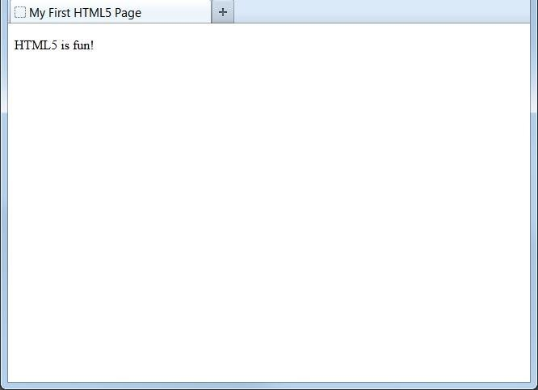

First Look at HTML5
Even though we used HTML5, the page looks exactly the same in a web browser as it would in XHTML. Without looking at the source code, web visitors will not know which version of HTML the page was created with.

Slide 59
HTML5 Basic Elements
<header>: used to define a header for section or document
<footer>: used to define a footer for section or document
<article>: used to define a article
<section>: used to define a section within document
<nav>: used to define a navigation links
<menuitem>: used to define a list of menuitems
header, nav and footer are not doing fancy things like the other new HTML5 elements, but these elements are primarily designed to make the web structure more meaningful both for browsers and humans, just like how the World Wide Web inventor, Tim Barners-Lee, think of it.

Slide 60
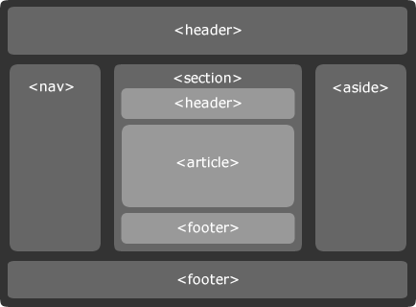
HTML5 Basic Elements

Slide 61

HTML5 Elements: Video
<!DOCTYPE HTML>
<html>
<body>
<video src="movie.ogg" width="320" height="240" controls="controls">
Your browser does not support the video tag.
</video>
</body>
</html>
The above example uses an Ogg file, and will work in Firefox, Opera and Chrome. To make the video work in Safari and future versions of Chrome, we must add an MPEG4 and WebM file.

Slide 62
HTML5 Elements: Video
<!DOCTYPE HTML>
<html>
<body>
<video width="320" height="240" controls="controls">
<source src="movie.ogg" type="video/ogg" />
<source src="movie.mp4" type="video/mp4" />
<source src="movie.webm" type="video/webm" /> Your browser does not support the video tag.
</video>
</body>
</html>

Slide 63
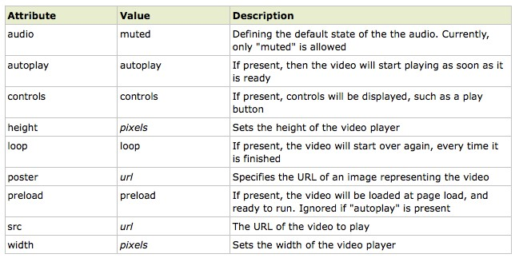
HTML5 Elements: Video

Slide 64
HTML5 Elements: Audio
<!DOCTYPE HTML>
<html>
<body>
<audio controls="controls">
<source src="song.ogg" type="audio/ogg" />
<source src="song.mp3" type="audio/mpeg" />
Your browser does not support the audio element.
</audio>
</body>
</html>

Slide 65
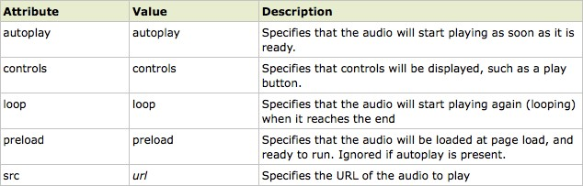
HTML5 Elements: Audio

Slide 66
HTML5 Elements: Input Types
HTML5 has several new input types for forms.
email
url
number
range
date pickers (date, month, week, time, datetime, datetime-local)
color

Slide 67
HTML5 Elements: Input Attributes
HTML5 has several new input attributes for forms.
required
autofocus
min, max, step
pattern
placeholder
readonly

